Slide 1
Global Covid Data Repository
DATA 422 Group Project
Emily, Sarmilan, Ajay, Wuqiu, Thanh

Slide 2
About the Dataset
Wikipedia articles and UN statistical database
219 countries
Variables : GDP, Population Density, MtoF ratio etc
Can help Governments with policy reforms

Slide 3
Process
Analysis
Create visualisations to highlight key trends in the data.
Scraping
Scrape and consolidate covid data from Wikipedia articles and UN website.
04
01
03
Wrangling
Perform data validation, cleaning and transformation to ensure accuracy and reliability.
Data Modelling
Create a data model to establish relationship between the different tables.
02

Slide 4
Project Workflow
To track code changes and roll back to previous versions seamlessly.
Fosters collaboration with team.
Can be used to perform code review.
Github - Version Control
Provides a visual representation of tasks, their status, and who's working on them.
Allows task prioritisation.
Empowers the team by adopting the ‘pull approach’ to task assignment so members can work at their own pace flexibly.
Trello - Project Management

Slide 5
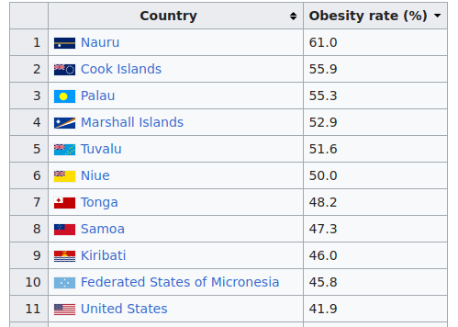
Data Scraping - Wiki Tables
Three tables, consistent country names
Pre-cleaning footnotes & symbols

Slide 6
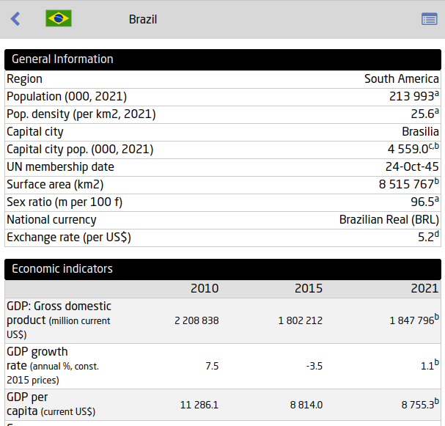
Data Scraping - UNdata
List of countries and local links
Three to four tables per country
Notes:
https://data.un.org/

Slide 7
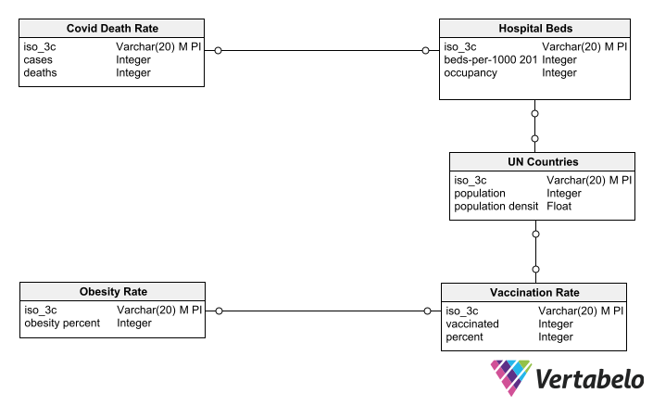
Data Model
Used the CountryCode package to convert country names into iso3 codes that can act as the primary key.

Slide 8
Data Wrangling
Handling Missing Values
Ensuring Unique Identifiers
Data Transformation
Notes:
90uujpoj

Slide 9
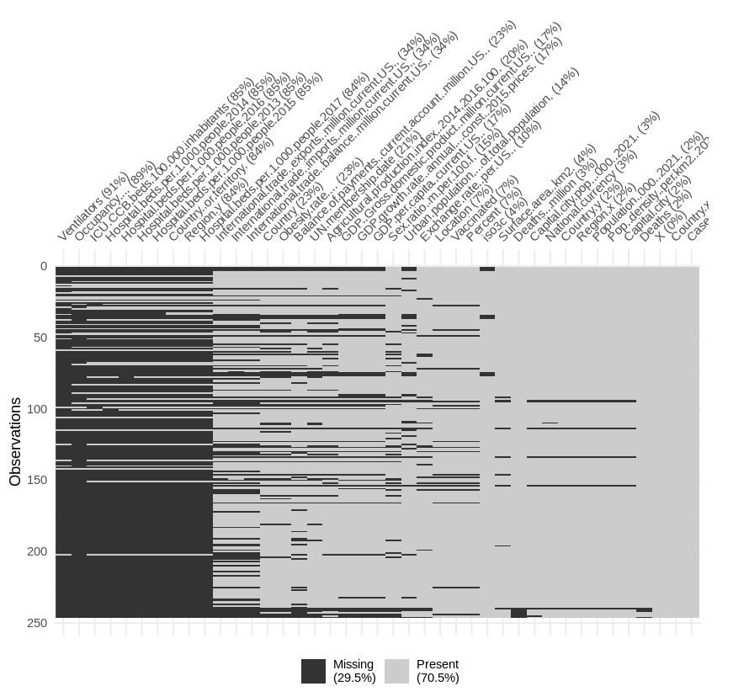
Handling Missing Values
The vis_miss function from the visdat package is used to visualise the missingness of each variable in the dataset.
The percentage of missing values for each variable is calculated.
Variables with less than 50% missing values are retained, while others are discarded.
Notes:
In our dataset, each row uniquely represents a country, making it a snapshot of that country's specific circumstances, attributes, and conditions. In our case, each country has its own unique socio-economic, cultural, political, and environmental factors.
Attempting to fill missing values for one country based on data from another might introduce biases or inaccuracies.
Given the importance of maintaining the integrity and authenticity of our data, we've decided that it's more appropriate, in this context, to work with the data we have rather than make assumptions about what the missing data might be.

Slide 10
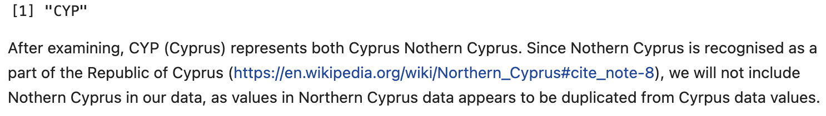
Ensuring Unique Identifiers
Rows with NA values in the iso3c column are removed, as iso3c will be used as unique identifier for each country.
Duplicated rows based on the iso3c column are identified and displayed.
Notes:
Ensures that we have complete information for the key identifier in the dataset.

Slide 11
Data Transformation
Convert numerical columns to appropriate data type
Remove redundant location related columns.
Columns are renamed to more descriptive names, making the dataframe more readable and easier to work with.
Notes:
As we decided to use iso3c country codes as unique identifiers, we will remove other redundant location related columns, as we’re interested in the countries in particular.
The transformation steps taken improve the clarity and usability of the dataset for further analysis.

Slide 12
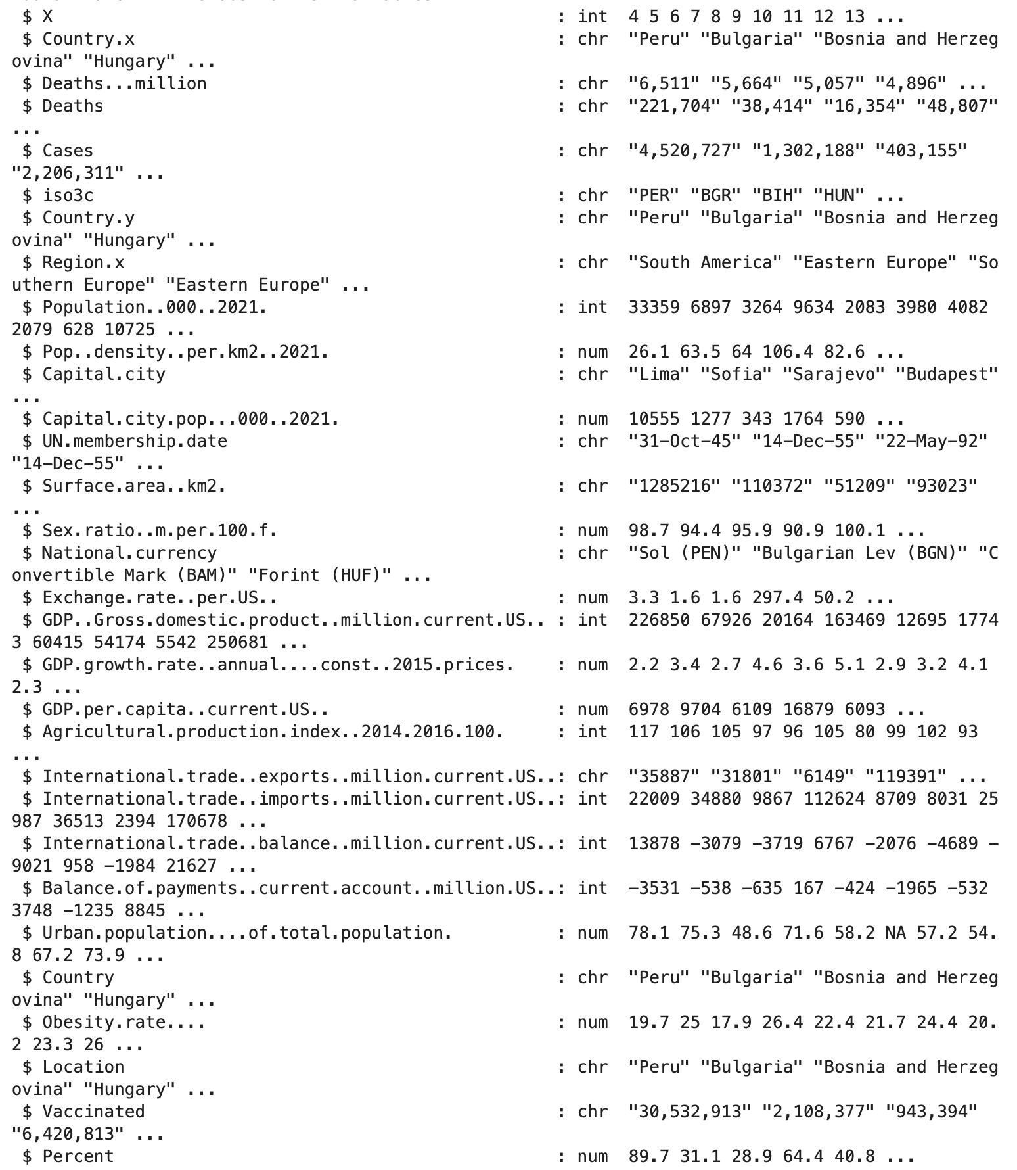
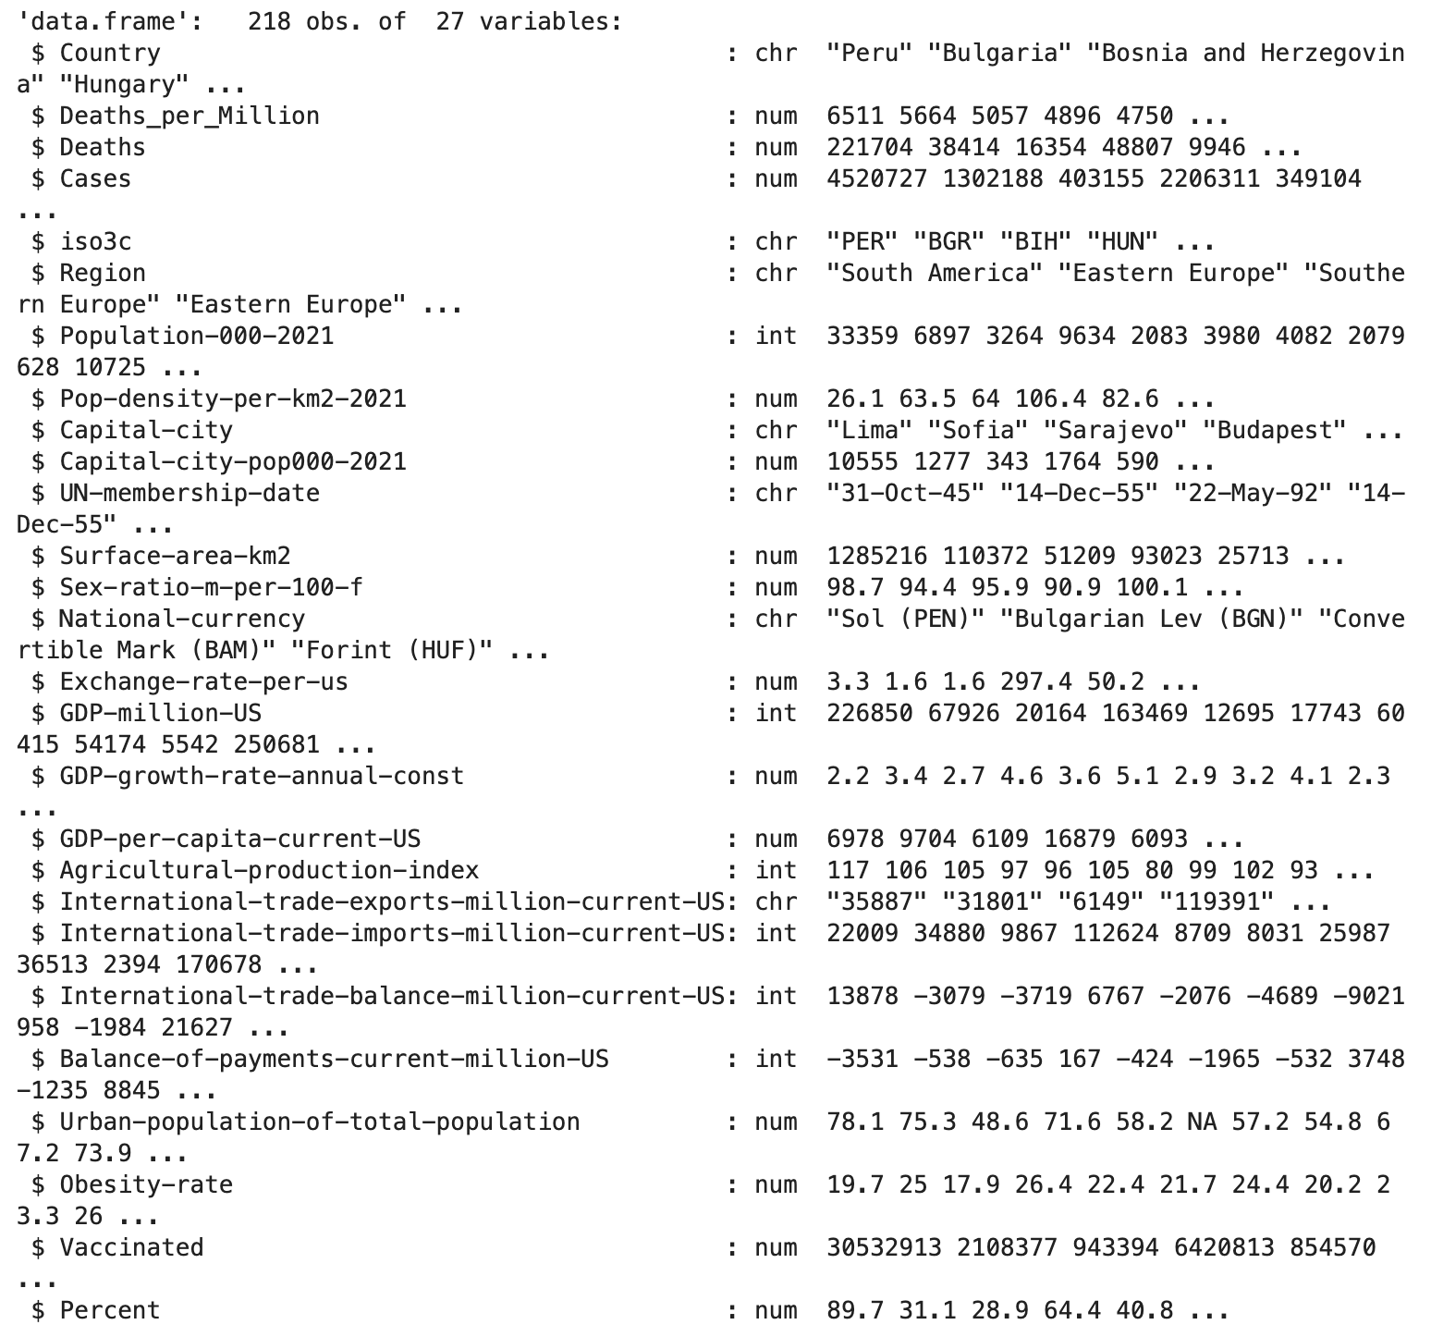
Data Transformation
Year ambiguity
Notes:
Year ambiguity: cannot transformed UN-membership-date column to “Date” format. We decided to keep the original format as the format is human-readable and the primary use case is for display purposes. There’s no immediate need to perform date transformation on this column.

Slide 13
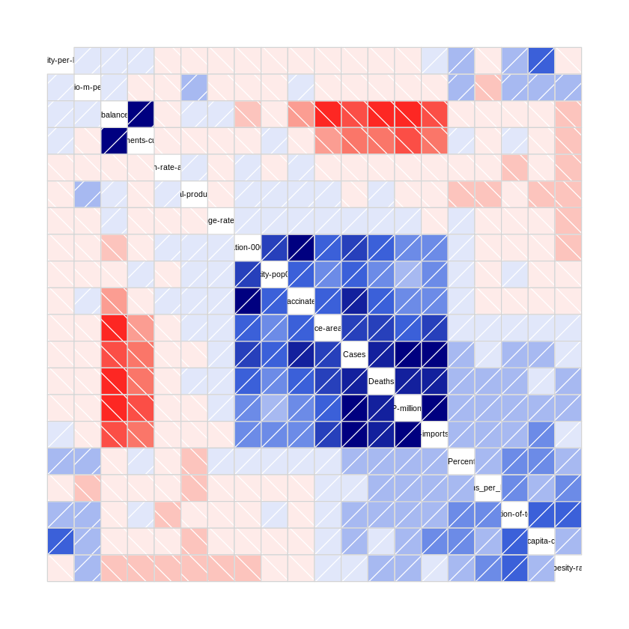
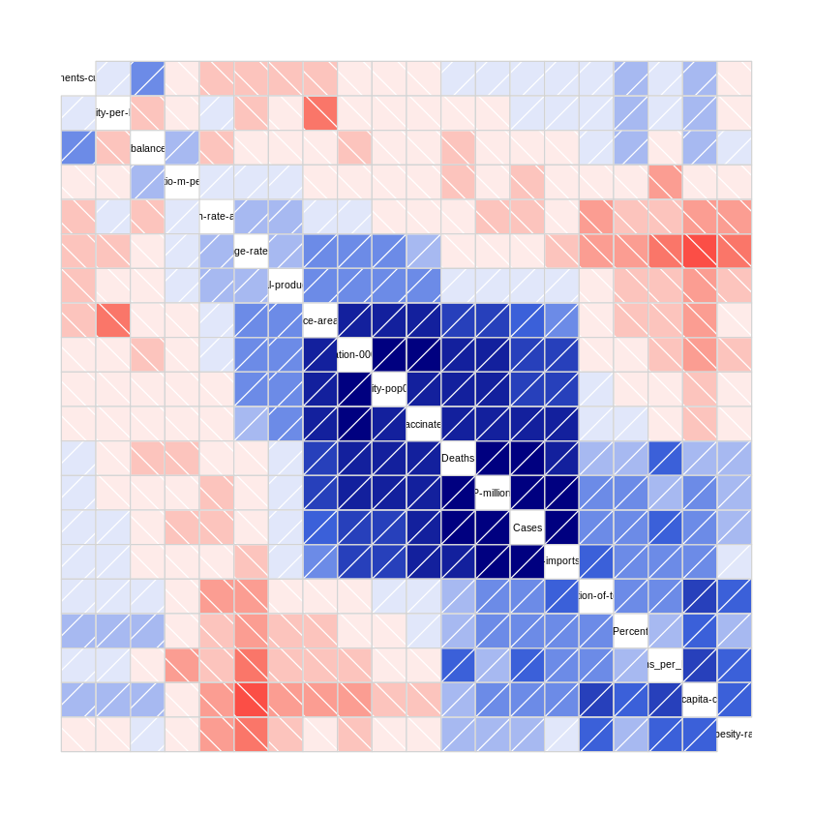
Analysis
Correlation method: Pearson
Correlation method: Spearman
Highly correlated variables:
Population-000-2021
Capital-city-pop-000-2021
Vaccinated
Surface-area-km2
Cases
Deaths
GDP-million-US
International-trade-imports-million-current-US
These variables have low missingess, which data would be more available and reliable for analysis.

Slide 14
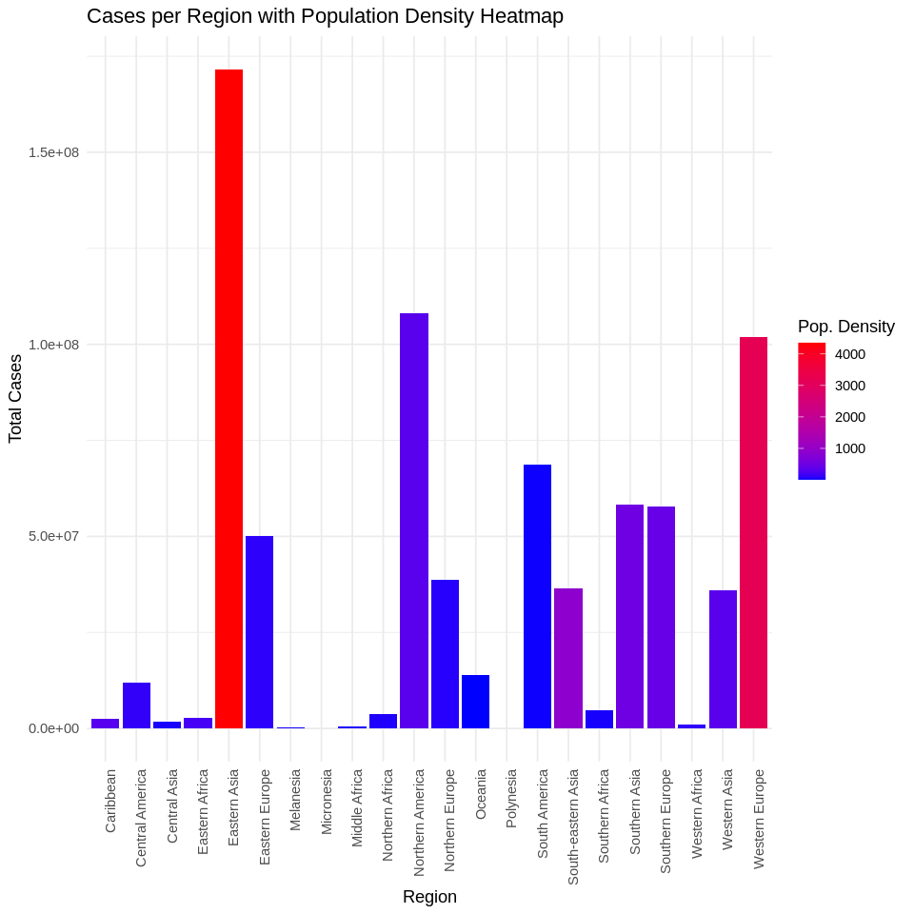
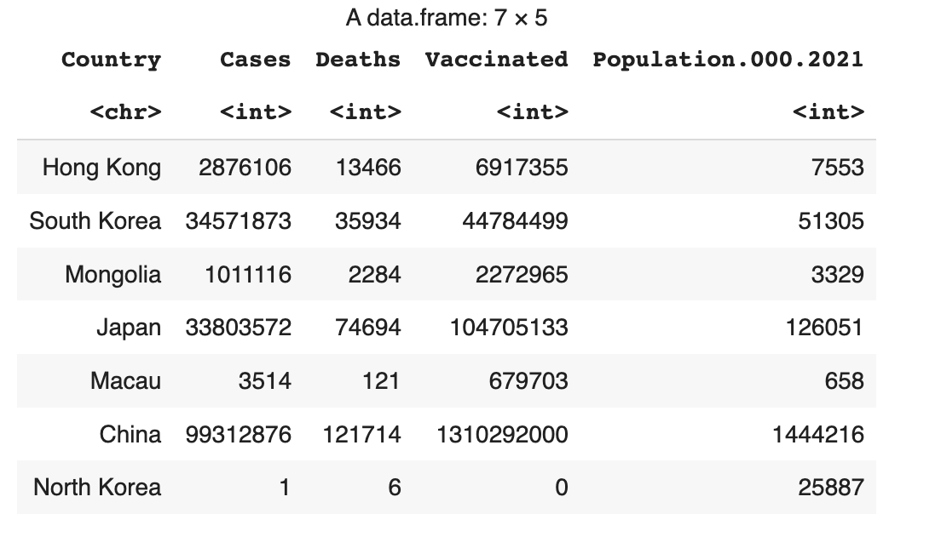

Slide 15
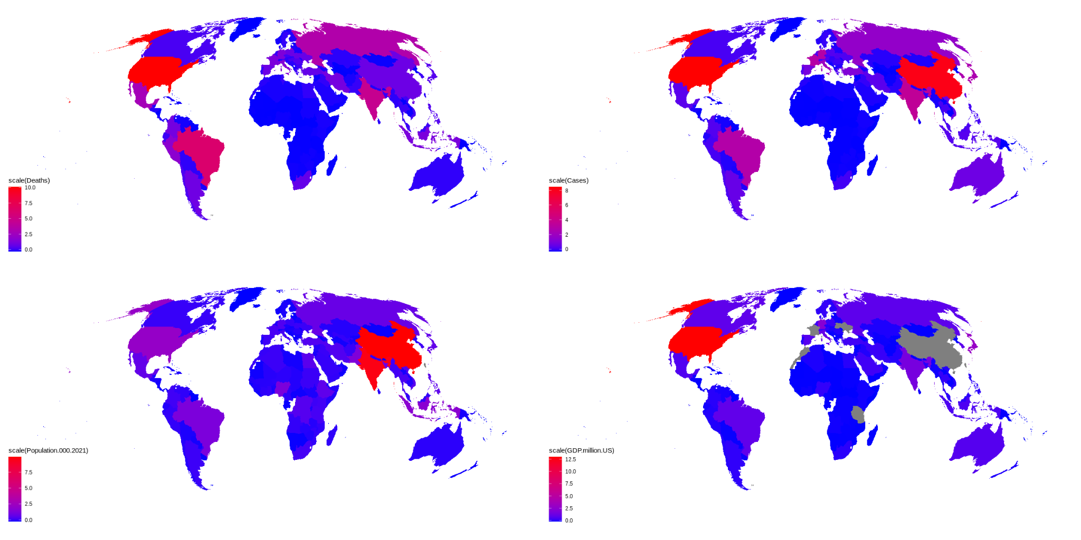

Slide 16
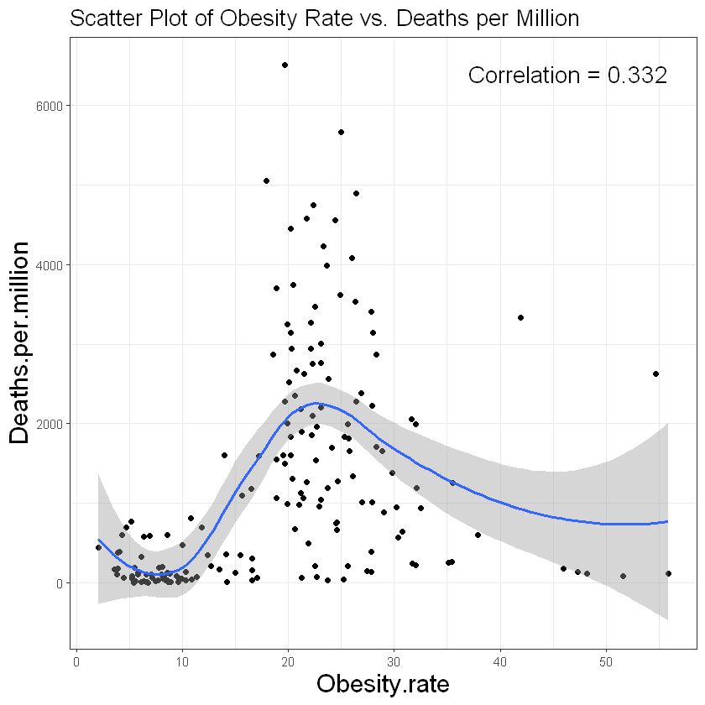

Slide 17
